Slide 1
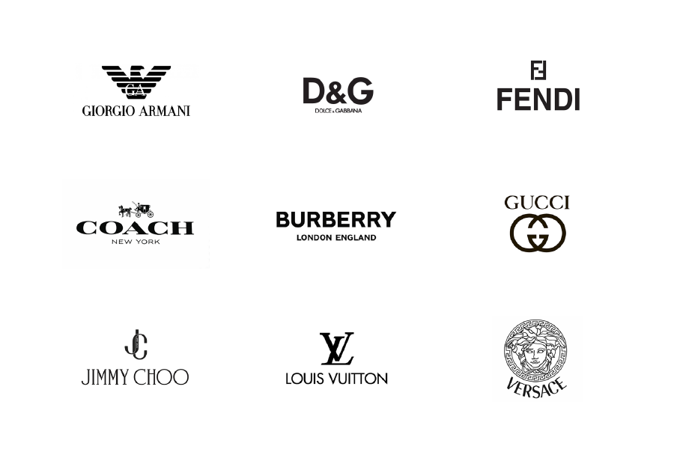
The Smile of customers
affected by Brand Culture

Slide 2
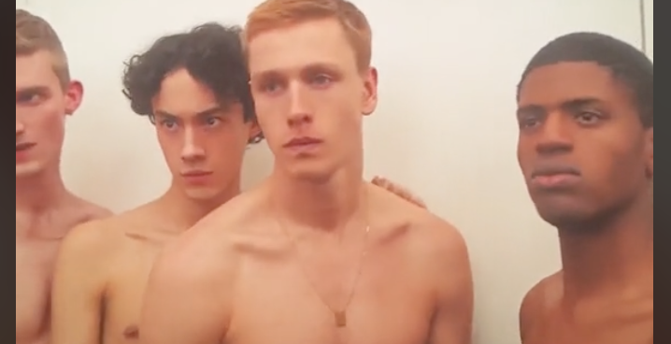
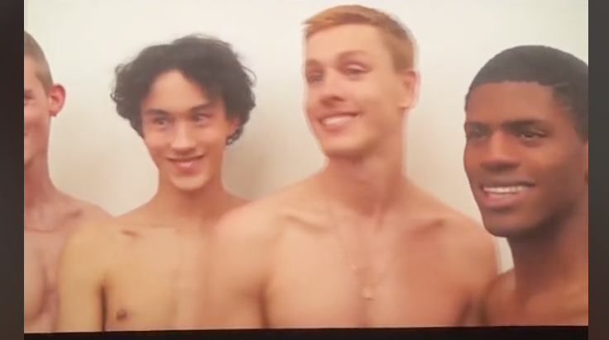
Interest From: A Tik Tok video
Balenciaga
H&M
A video talking about how models switch their emotional status between different fashion brands (link)

Slide 3
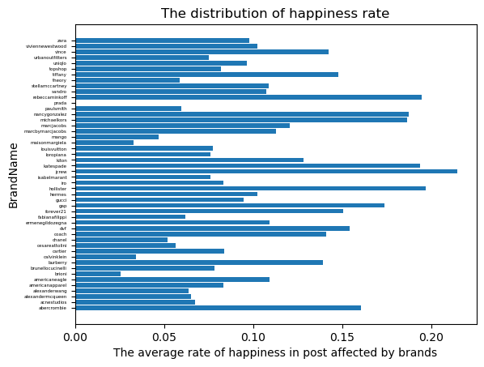
Preliminary Finding

Slide 4
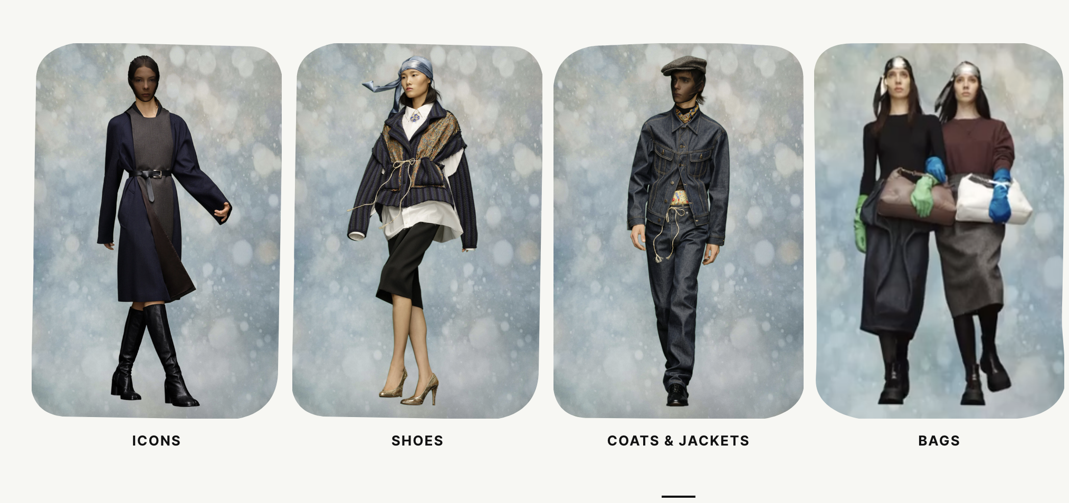

Slide 5
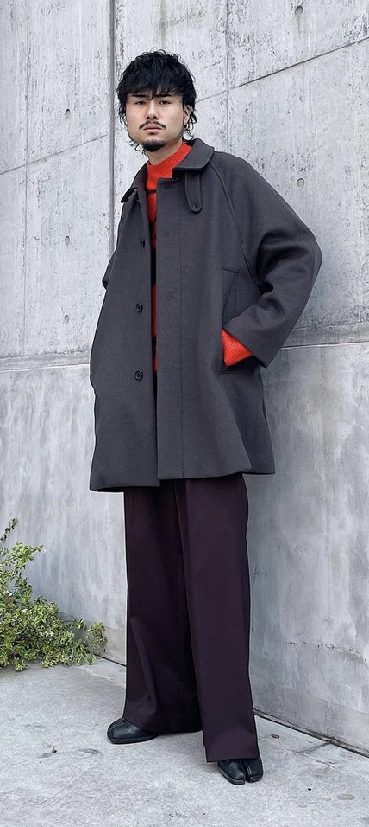
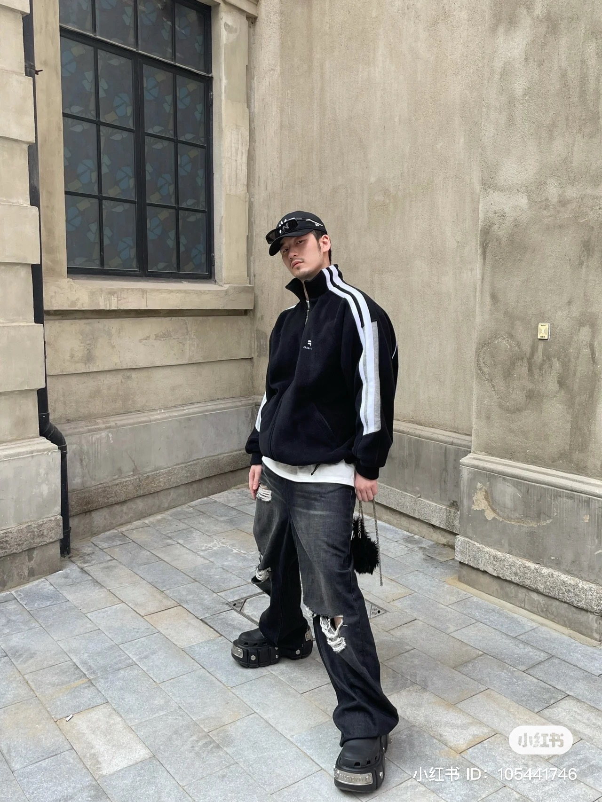
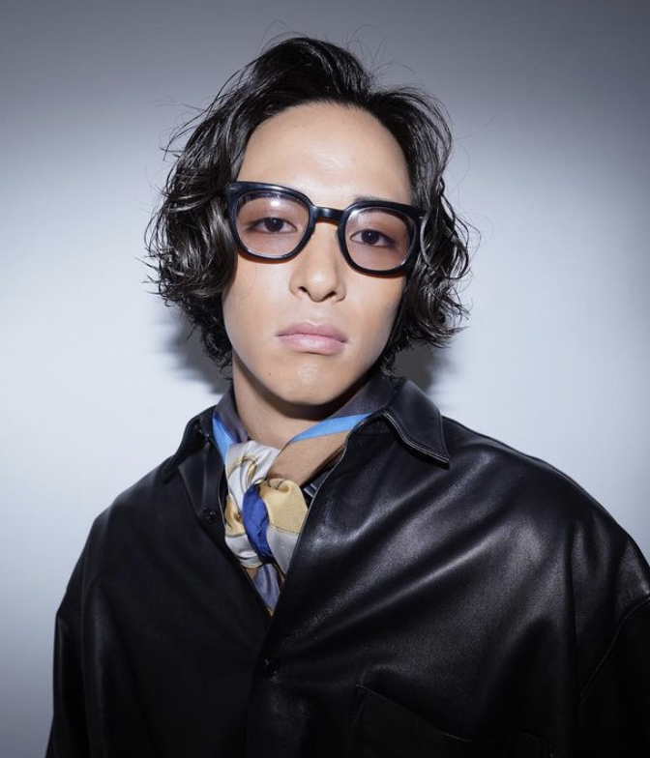

Slide 6
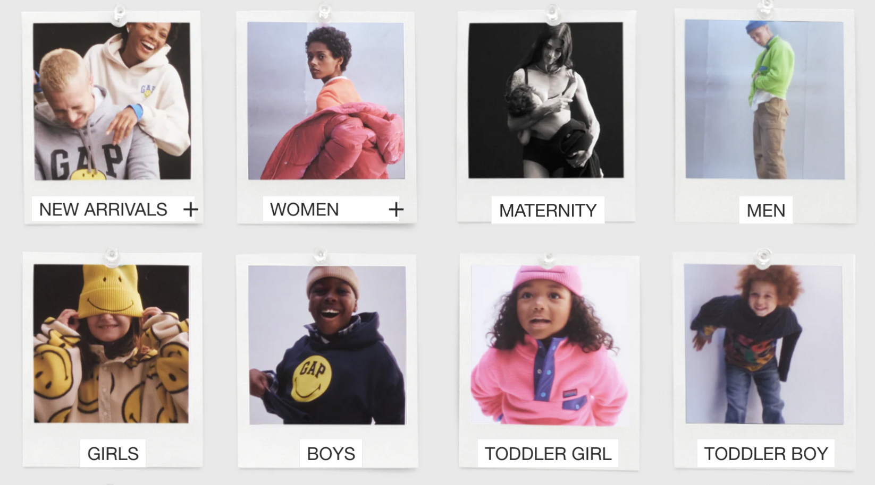

Slide 7
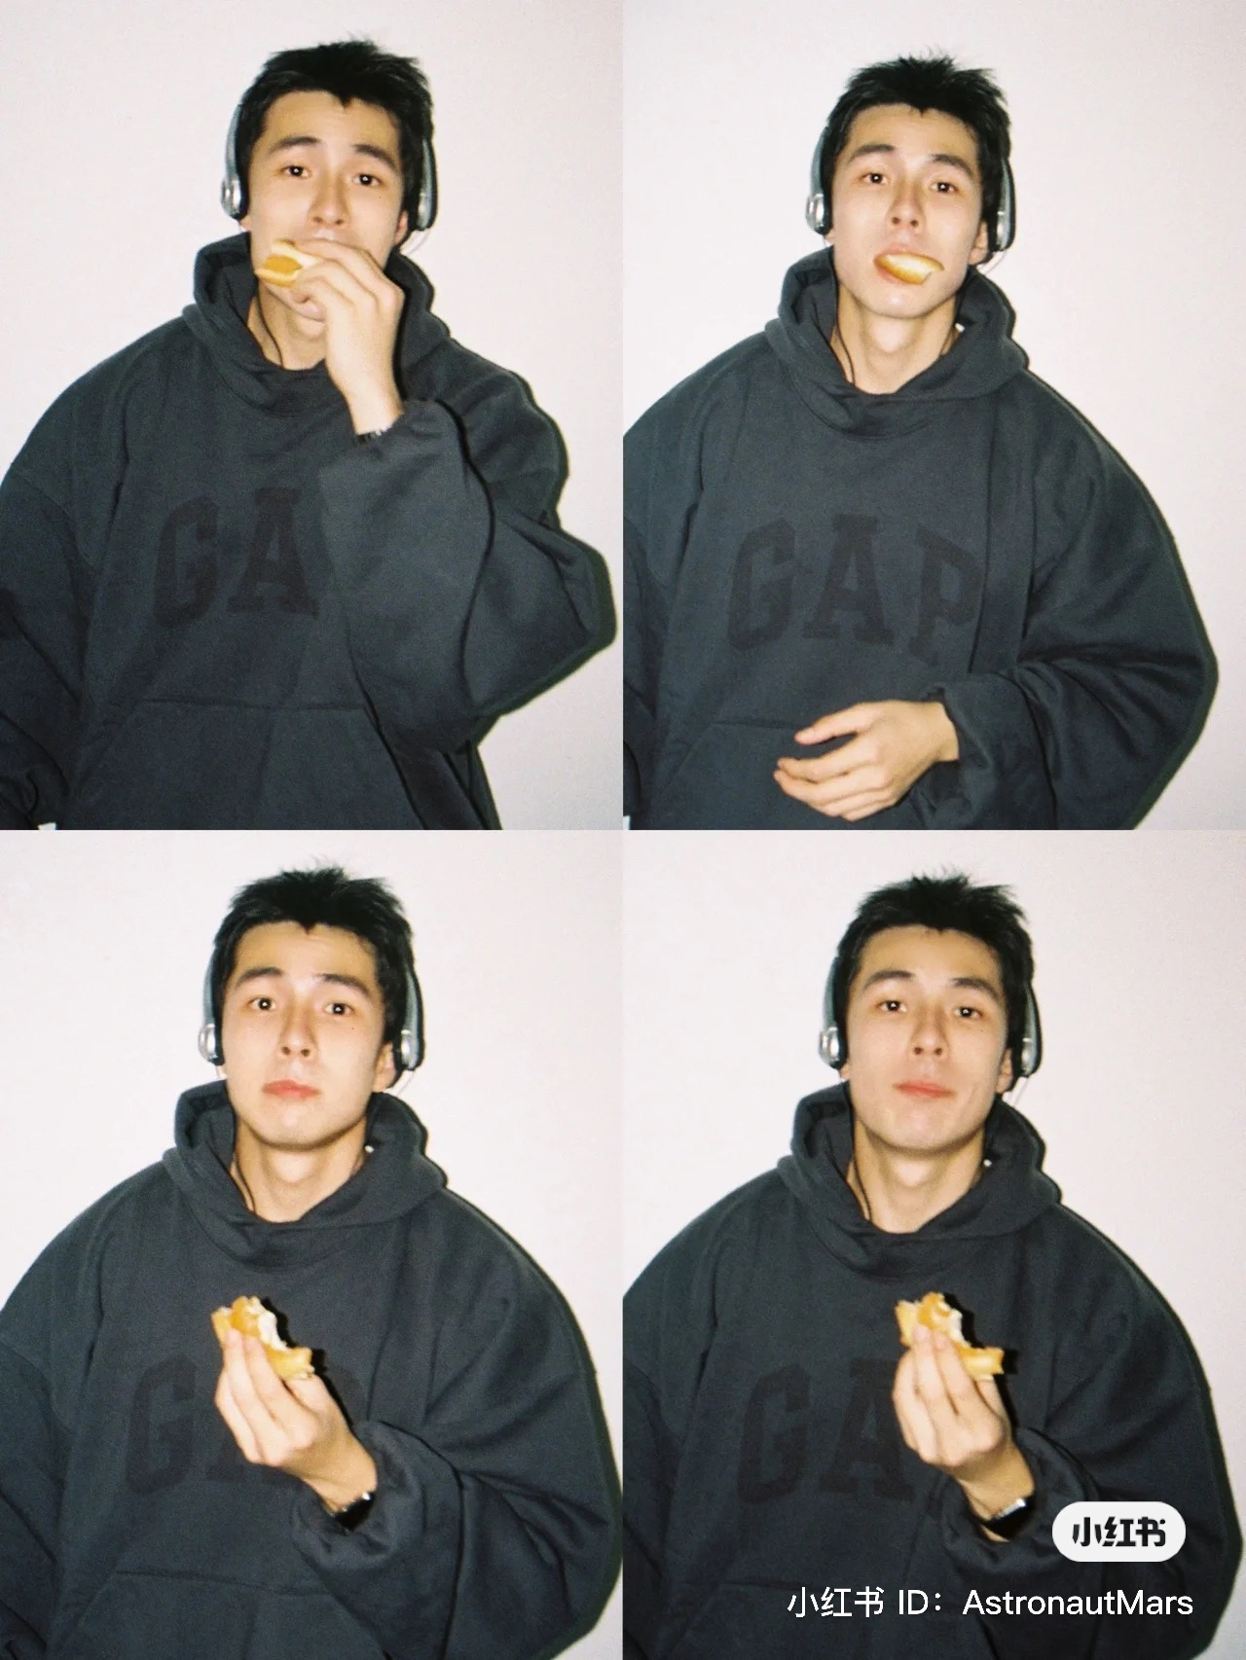
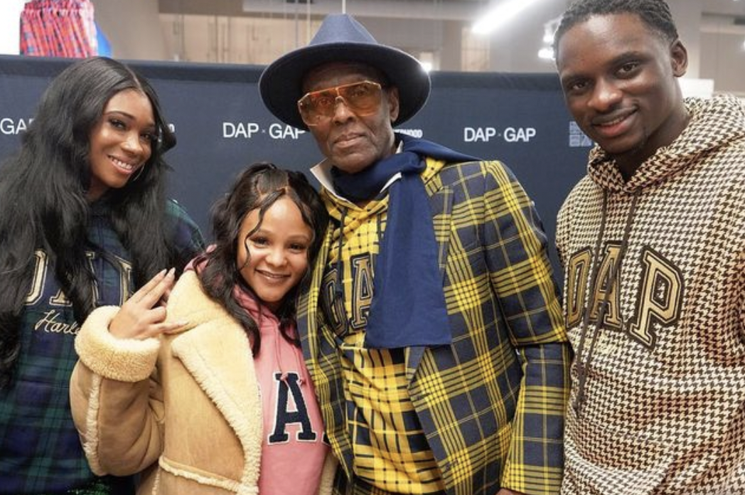

Slide 8
Sign-Vehicle
Smile
Symbolic
Dicents
Sign
Interpretant
Distance from ordinary consumers
The facial expression in posts

